Slide 2
USA trafficking facts
100,000 to 300,000 American girls
Ages 10 – 18 (average age 13)
Technology is used extensively
Bay Area is a hub of activity
I-880 and I-680 corridors
Limited national resources

Slide 3
Who We Are
Who we are
Founded 10 years ago
Faith based program
Partner with
Individuals
Corporations
Law enforcement
Parents
Other like-minded organizations
Rescue girls Bay Area & Nationwide

Slide 4
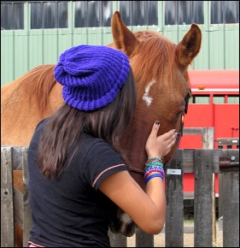
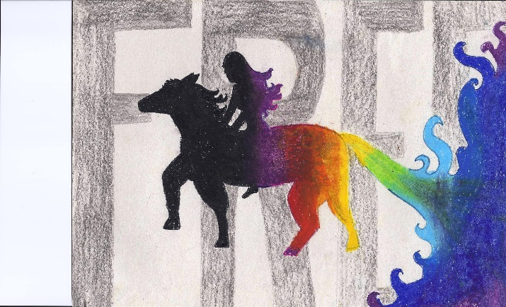
What we do
Provide
partnering with boarding schools/ranches/families
safe housing in several locations
loving family atmosphere
school
horse therapy
community service
fun activities

Slide 5
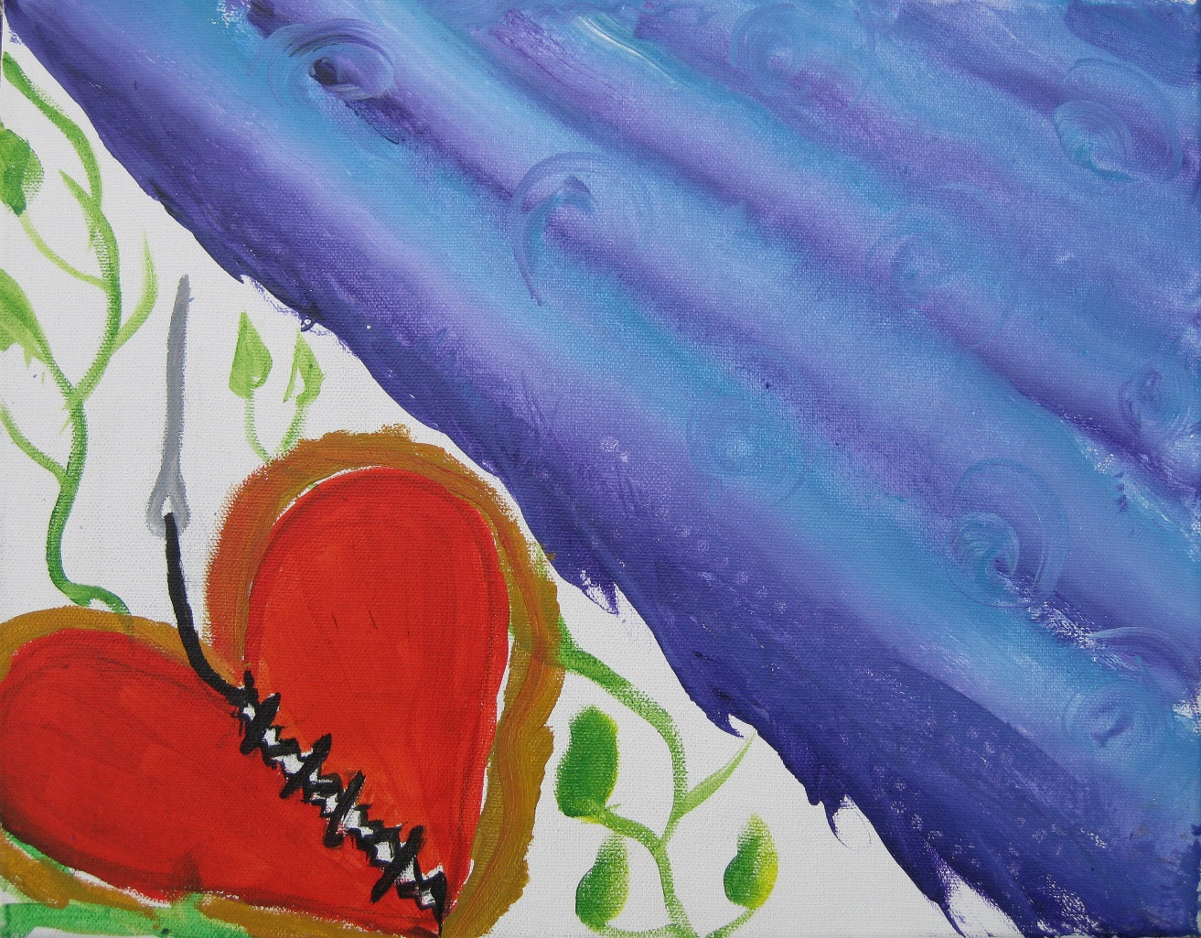
We mend hearts & souls

Slide 6
Real progress
Rescued 88+ girls last 10 years
80% Girls graduating and returning home
Girls going on to college
Planning the opening of a life skills center for girls over age 18

Slide 7
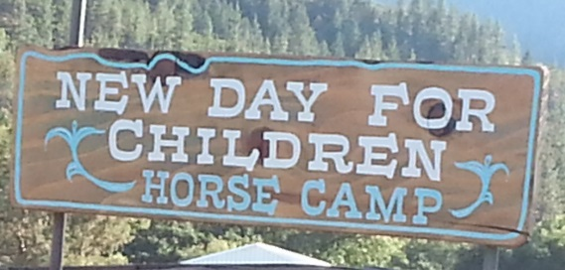

Slide 8
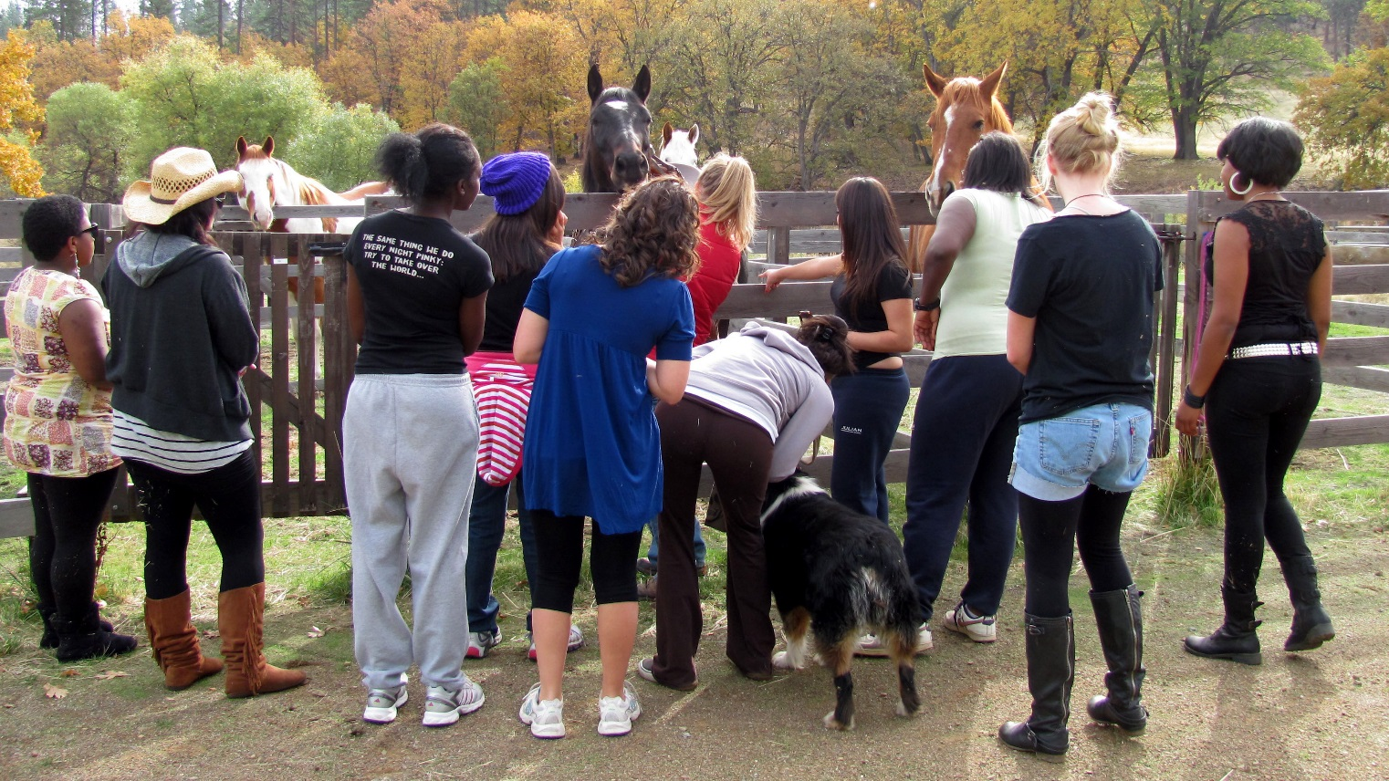

Slide 9
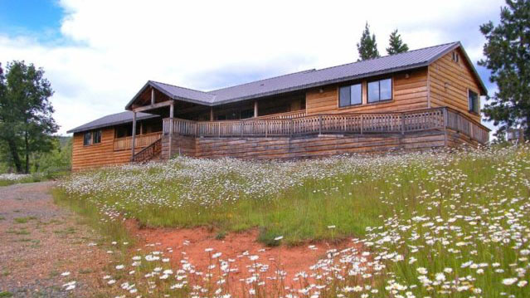
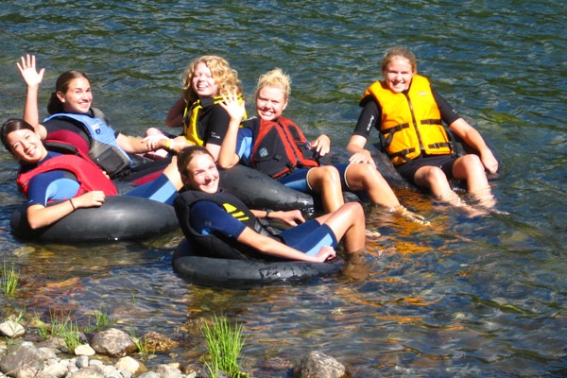
Having a little fun
girls are models for purpose of representing our program

Slide 10
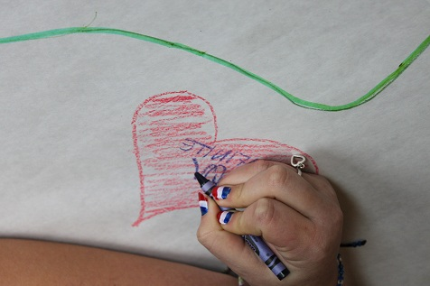
Finding heart and hand

Slide 11
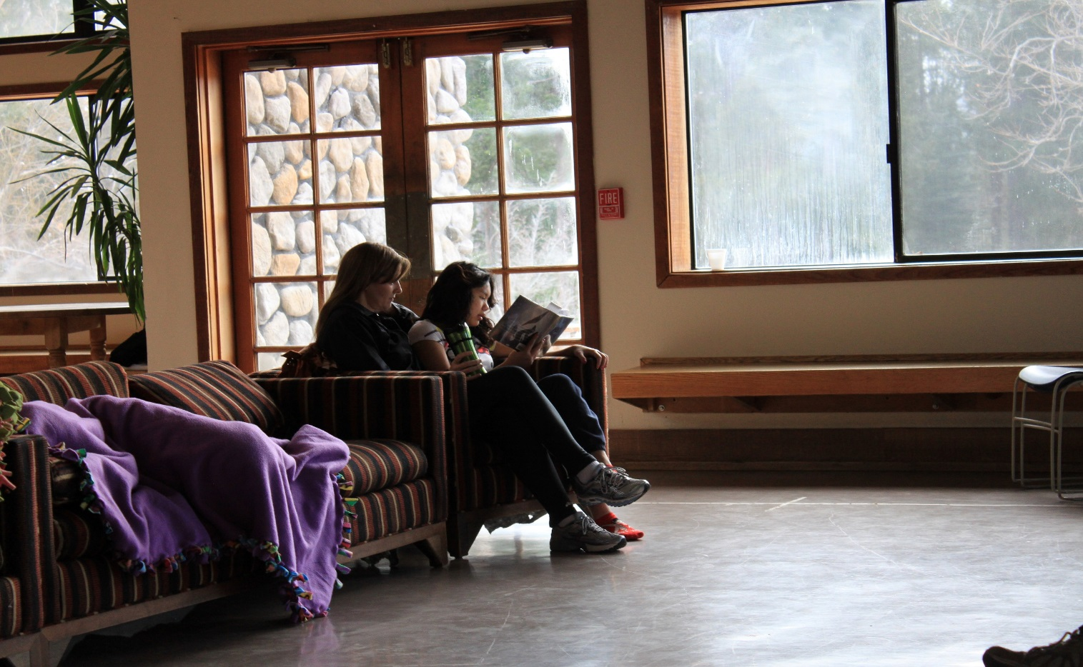
Reading with a friend

Slide 12
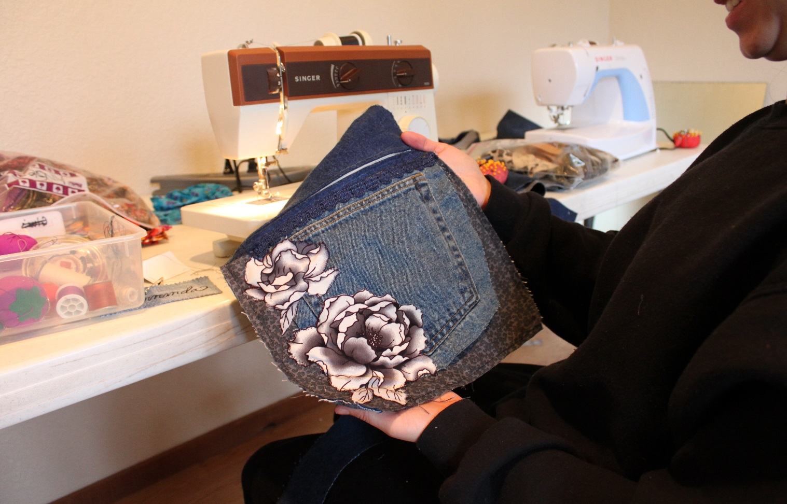
Learning to sew

Slide 13
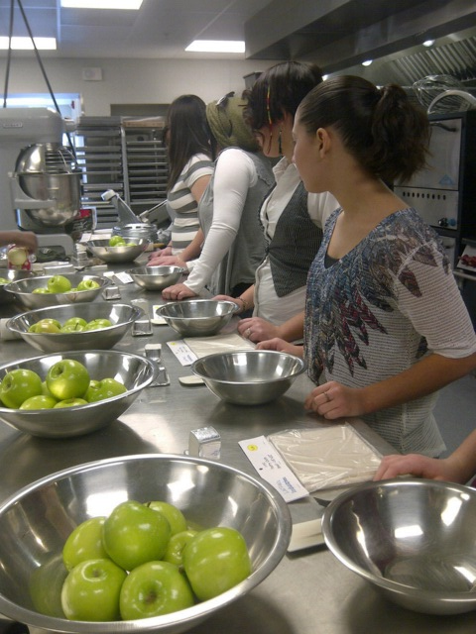
Serving others

Slide 14
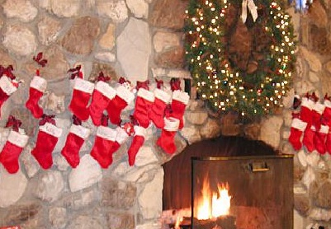
Celebrating Christmas as family

Slide 15
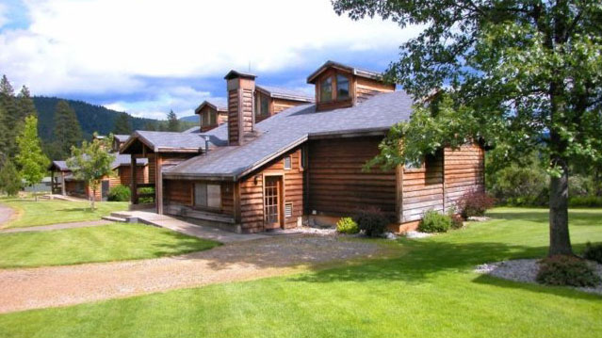
A cottage

Slide 16
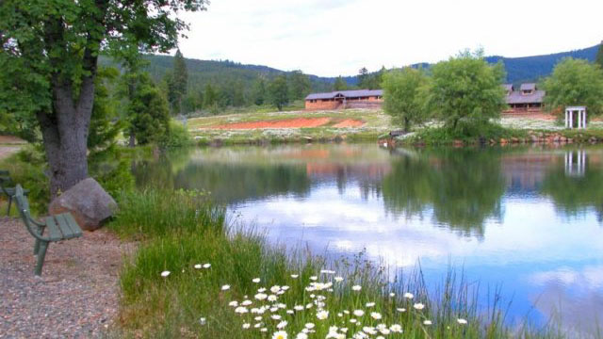
Our lake

Slide 17
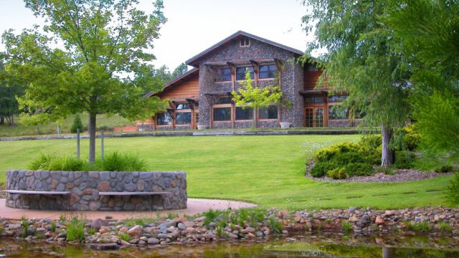
Dining hall

Slide 18
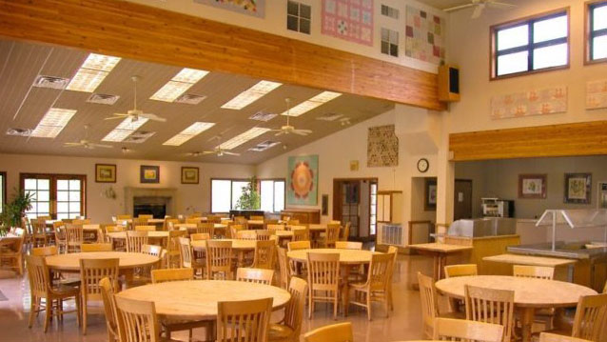
Dining hall

Slide 19
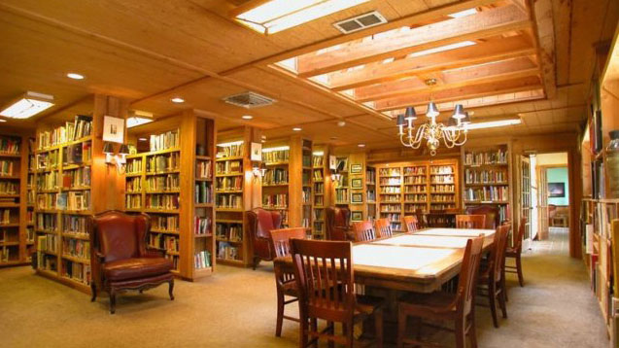
Library

Slide 20
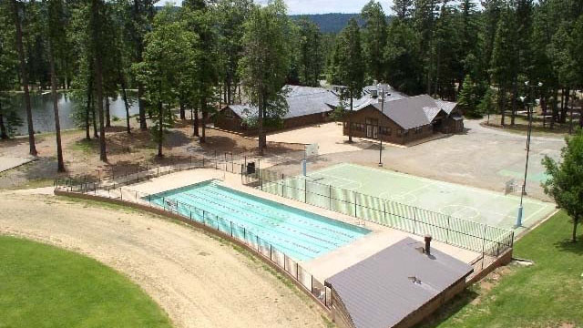
Pool & tennis court

Slide 21
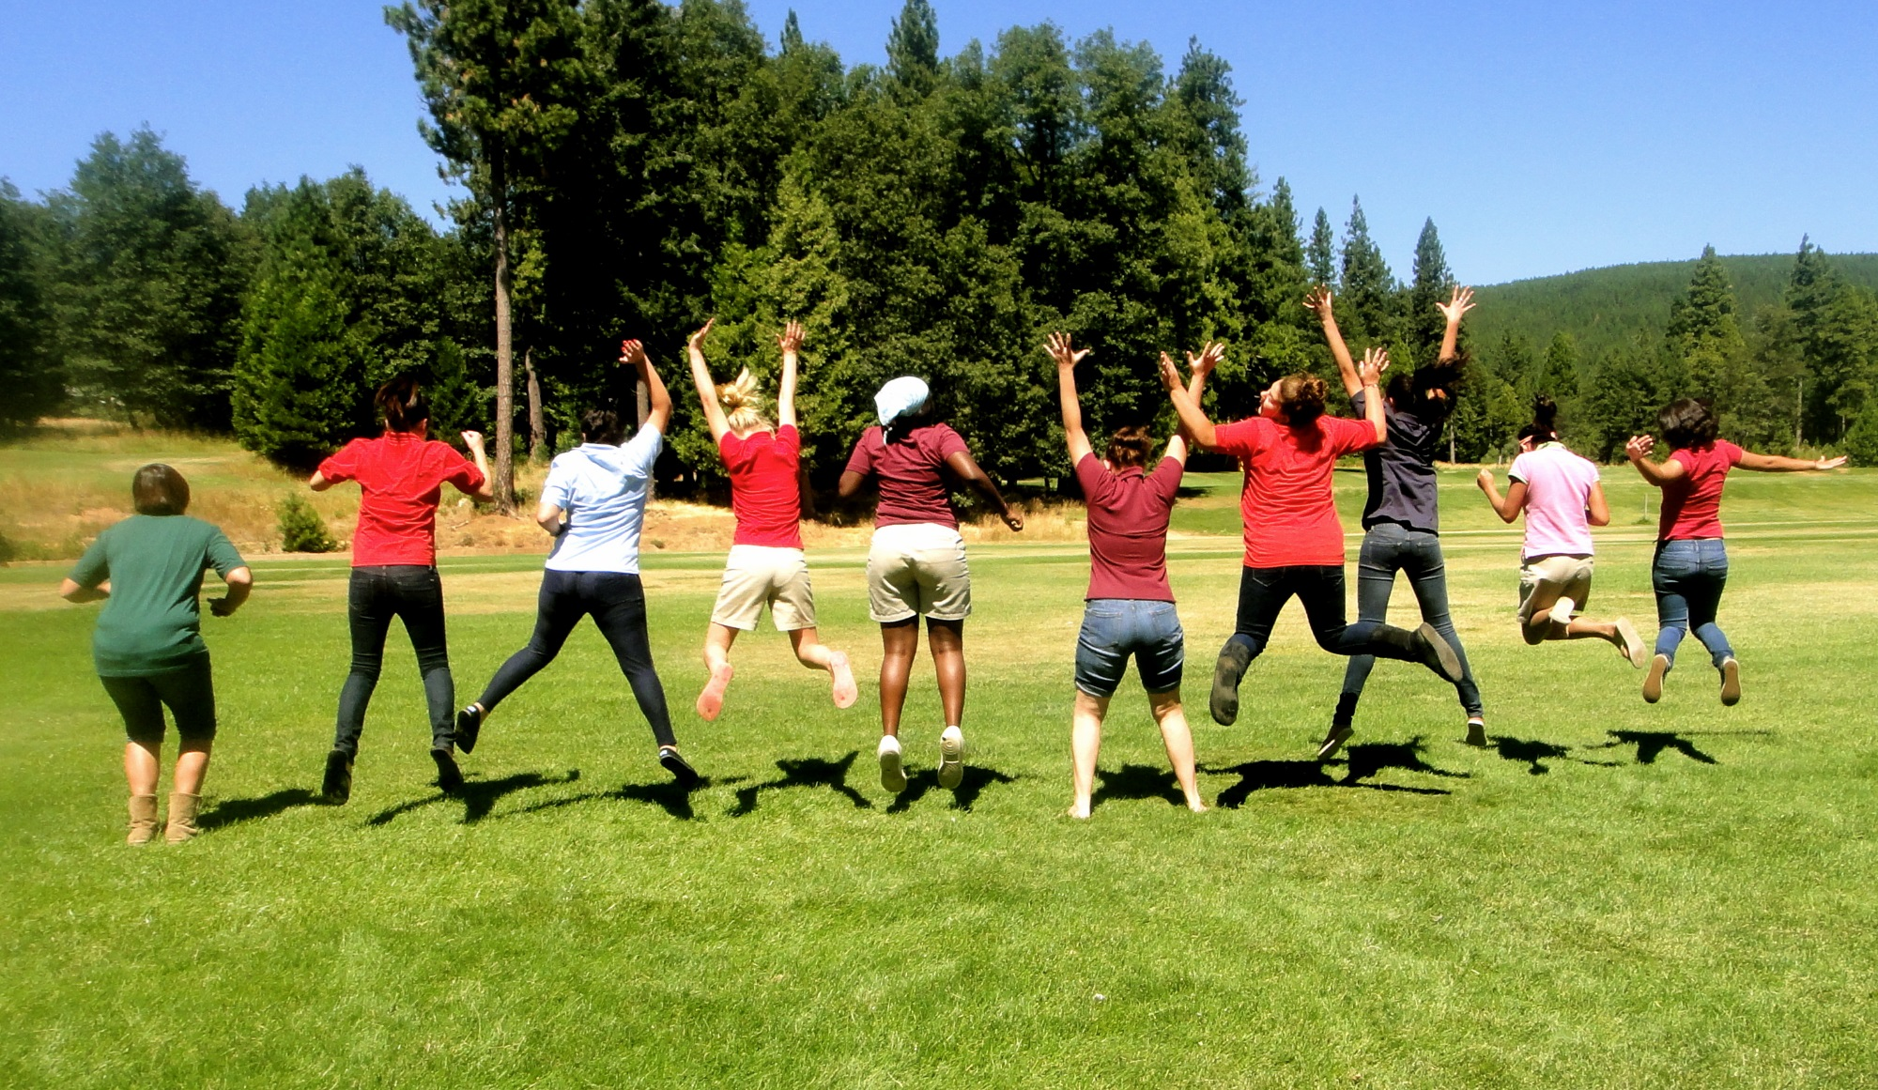
Thank You !
Thank You !

